Slide 1

Introduction to Reinforcement Learning – Term Project –
서강대학교 기계공학과
기말쉽게내조
320250213 표진우
120250367 이충현
Github page: https://github.com/RyanPyo/MPC-RL-cartpole

Slide 2
Contents
Introduction
System Modeling
Environment Configuration
Experiment Results
Comparison with SAC
Results & Conclusions
References

Slide 3
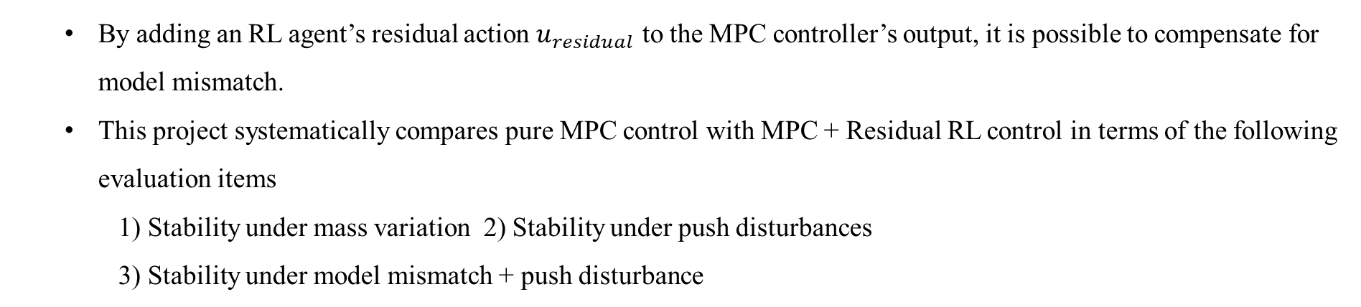
Introduction
<Project Background>
In real robotic control systems, model uncertainty significantly degrades the performance of model-based controllers.
Reinforcement Learning (RL) can compensate for uncertainty and nonlinearities through learning, but it often suffers from stability issues and low sample efficiency.
Recently, hybrid control frameworks that combine the stability and constraint-handling capability of Model Predictive Control (MPC) with the adaptability of RL have gained considerable attention.
<Problem Definition>
By adding an RL agent’s residual action $u_{residual}$ to the MPC controller’s output, it is possible to compensate for model mismatch.
This project systematically compares pure MPC control with MPC + Residual RL control in terms of the following evaluation items
1) Stability under mass variation 2) Stability under push disturbances 3) Stability under model mismatch + push disturbance

Slide 4
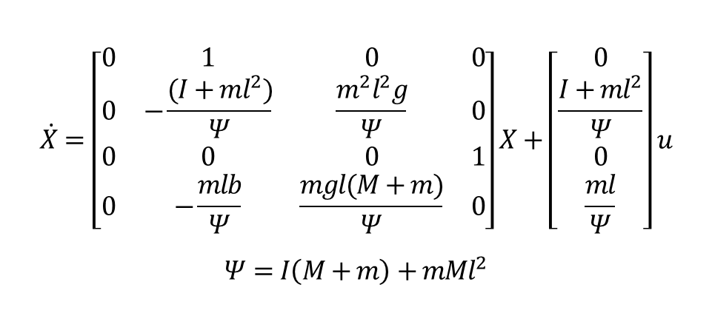
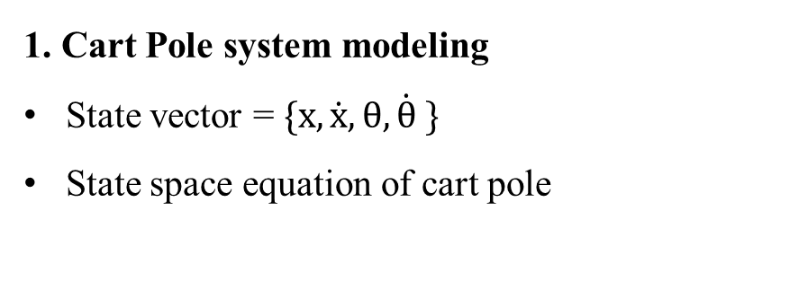
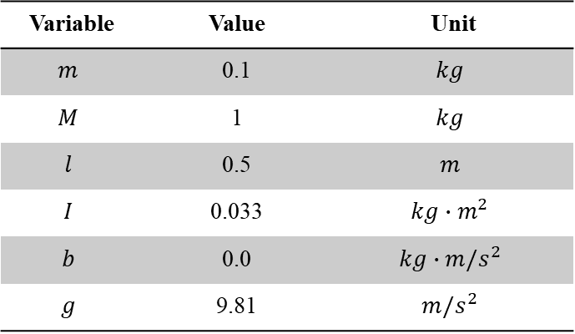
System Modeling
1. Cart Pole system modeling
State vector = $\{x, \dot{x}, θ, \dot{θ} \}$
State space equation of cart pole
$$m$$
$$y$$
$$θ$$
$$x$$
$$l$$
$$F$$
$$M$$
$$\dot{X}=\left[\begin{matrix}0 & 1 & 0 & 0 \\ 0 & −\frac{(I+ml^{2})}{Ψ} & \frac{m^{2}l^{2}g}{Ψ} & 0 \\ 0 & 0 & 0 & 1 \\ 0 & −\frac{mlb}{Ψ} & \frac{mgl(M+m)}{Ψ} & 0\end{matrix}\right]X+\left[\begin{matrix}0 \\ \frac{I+ml^{2}}{Ψ} \\ 0 \\ \frac{ml}{Ψ}\end{matrix}\right]u$$
$$Ψ=I\left(M+m\right)+mMl^{2}$$
Fig. 1: Schematic of the cart pole system
TABLE I: Parameters and Specifications
Variable | Value | Unit
$$m$$ | 0.1 | $$kg$$
$$M$$ | 1 | $$kg$$
$$l$$ | 0.5 | $$m$$
$$I$$ | 0.033 | $$kg∙m^{2}$$
$$b$$ | 0.0 | $$kg∙m/s^{2}$$
$$g$$ | 9.81 | $$m/s^{2}$$
Eq. 1: Linearized state-space model of the cart–pole dynamics.

Slide 5
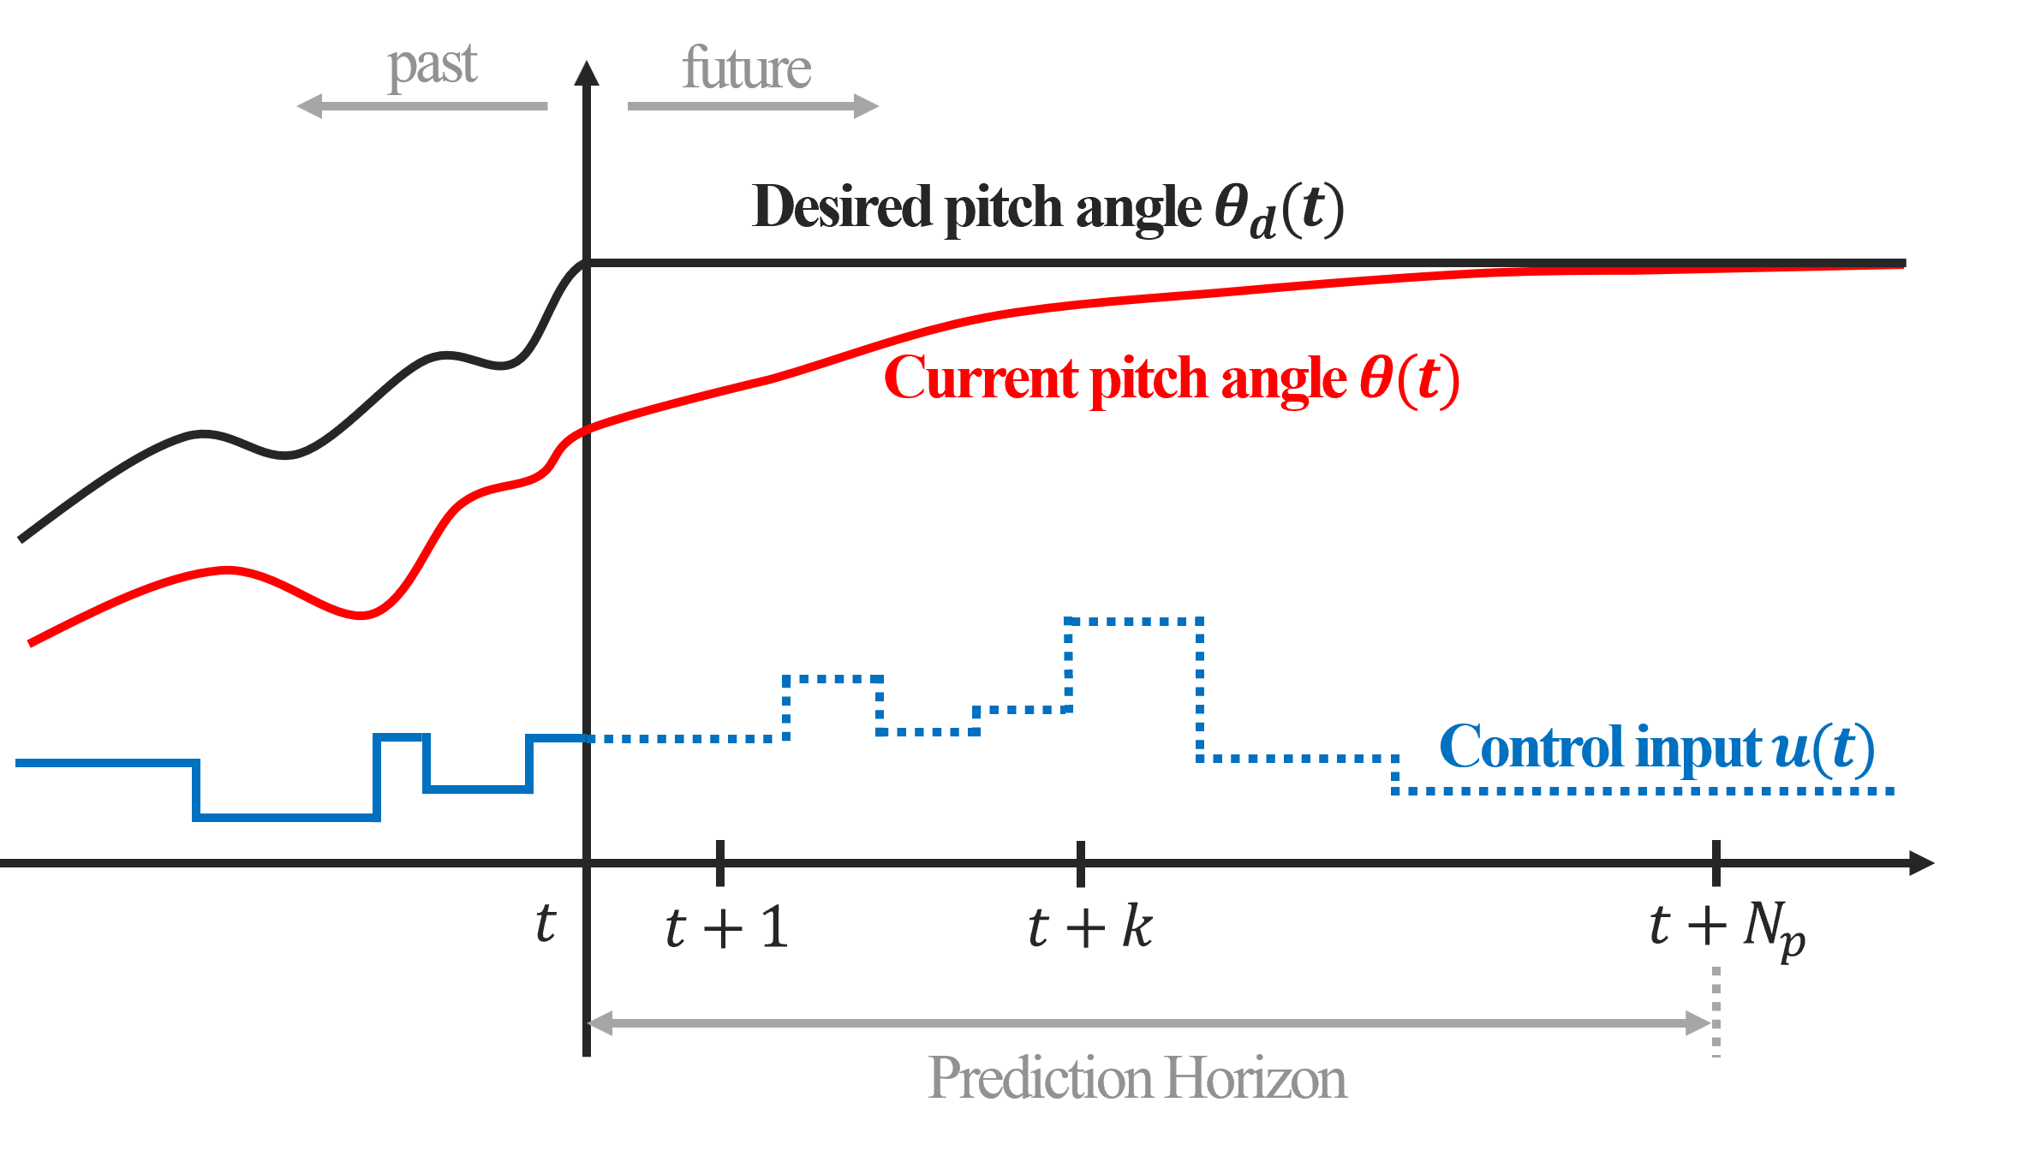
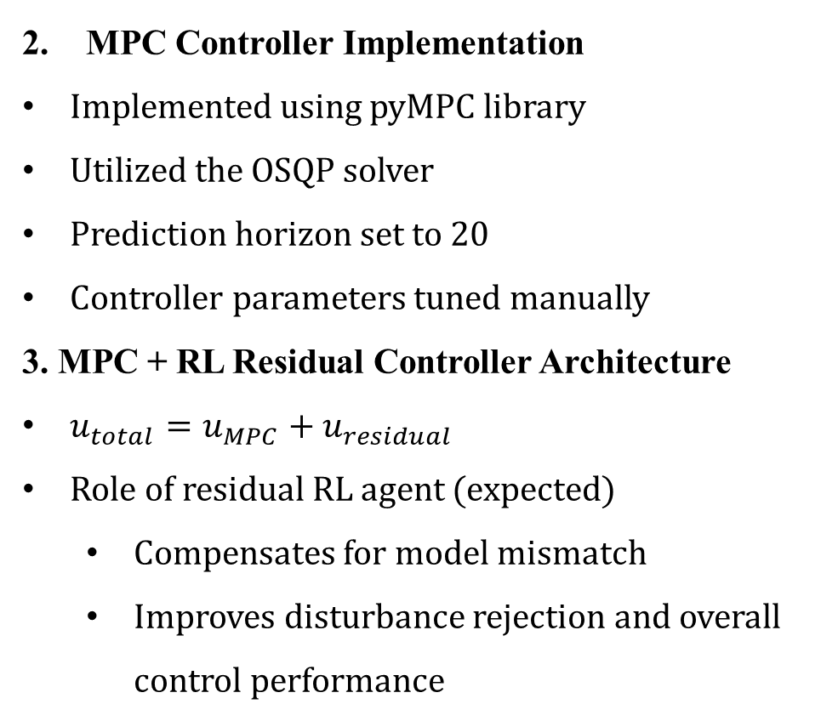
System Modeling
MPC Controller Implementation
Implemented using pyMPC library
Utilized the OSQP solver
Prediction horizon set to 20
Controller parameters tuned manually
3. MPC + RL Residual Controller Architecture
$u_{total}=u_{MPC}+u_{residual}$
Role of residual RL agent (expected)
Compensates for model mismatch
Improves disturbance rejection and overall control performance
Fig. 2: Illustration of the MPC prediction horizon, showing future reference tracking and the corresponding optimized control inputs.

Slide 6
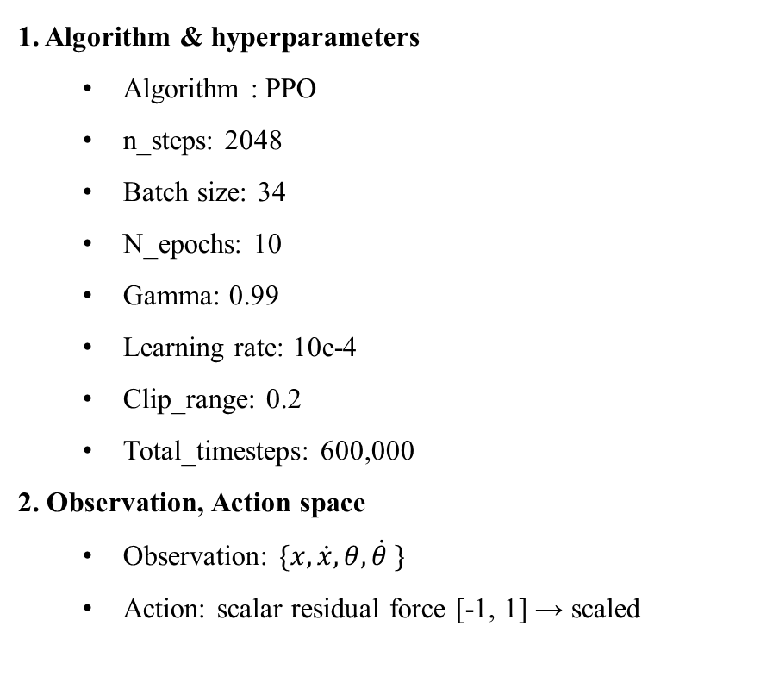
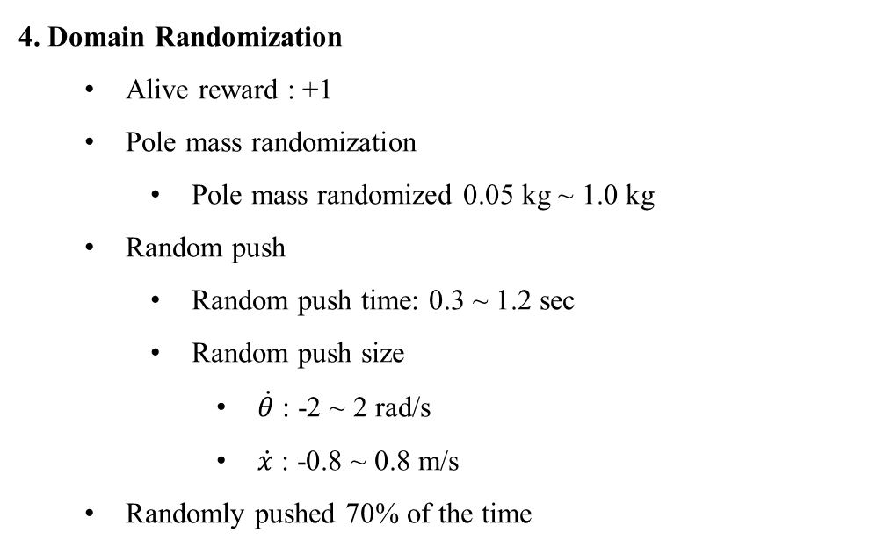
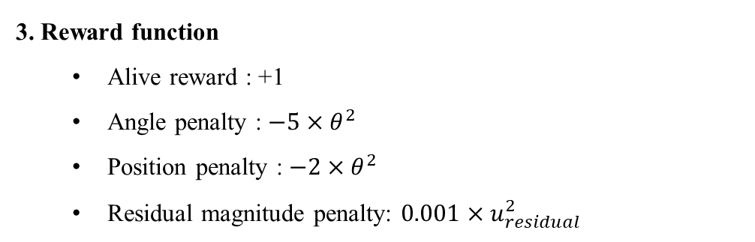
Environment Configuration
1. Algorithm & hyperparameters
Algorithm : PPO
n_steps: 2048
Batch size: 34
N_epochs: 10
Gamma: 0.99
Learning rate: 10e-4
Clip_range: 0.2
Total_timesteps: 600,000
2. Observation, Action space
Observation: $\{x, \dot{x}, θ, \dot{θ} \}$
Action: scalar residual force [-1, 1] → scaled
3. Reward function
Alive reward : +1
Angle penalty : $−5×θ^{2}$
Position penalty : $−2×θ^{2}$
Residual magnitude penalty: $0.001×u_{residual}^{2}$
4. Domain Randomization
Alive reward : +1
Pole mass randomization
Pole mass randomized 0.05 kg ~ 1.0 kg
Random push
Random push time: 0.3 ~ 1.2 sec
Random push size
$\dot{θ}$ : -2 ~ 2 rad/s
$\dot{x}$ : -0.8 ~ 0.8 m/s
Randomly pushed 70% of the time

Slide 7
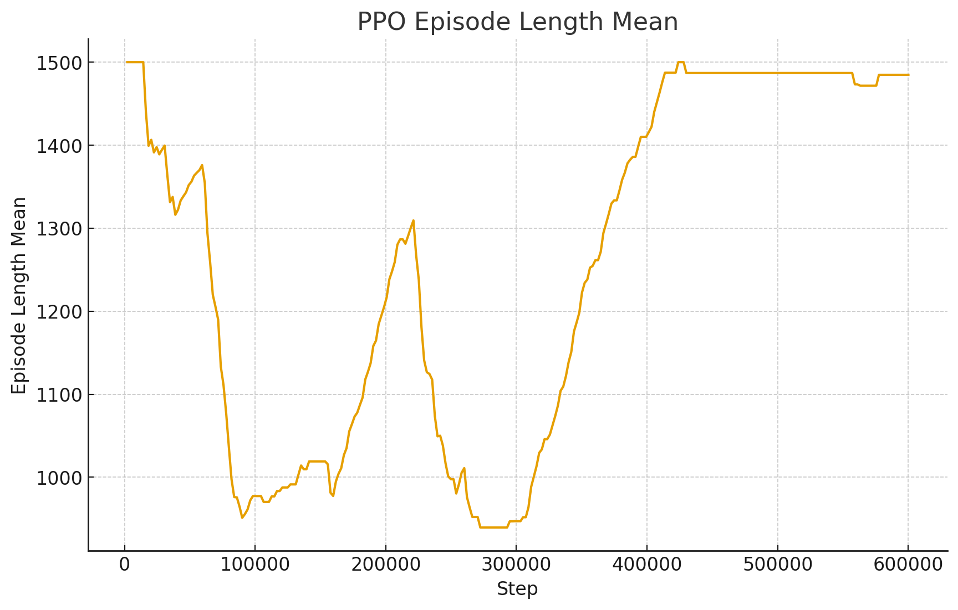
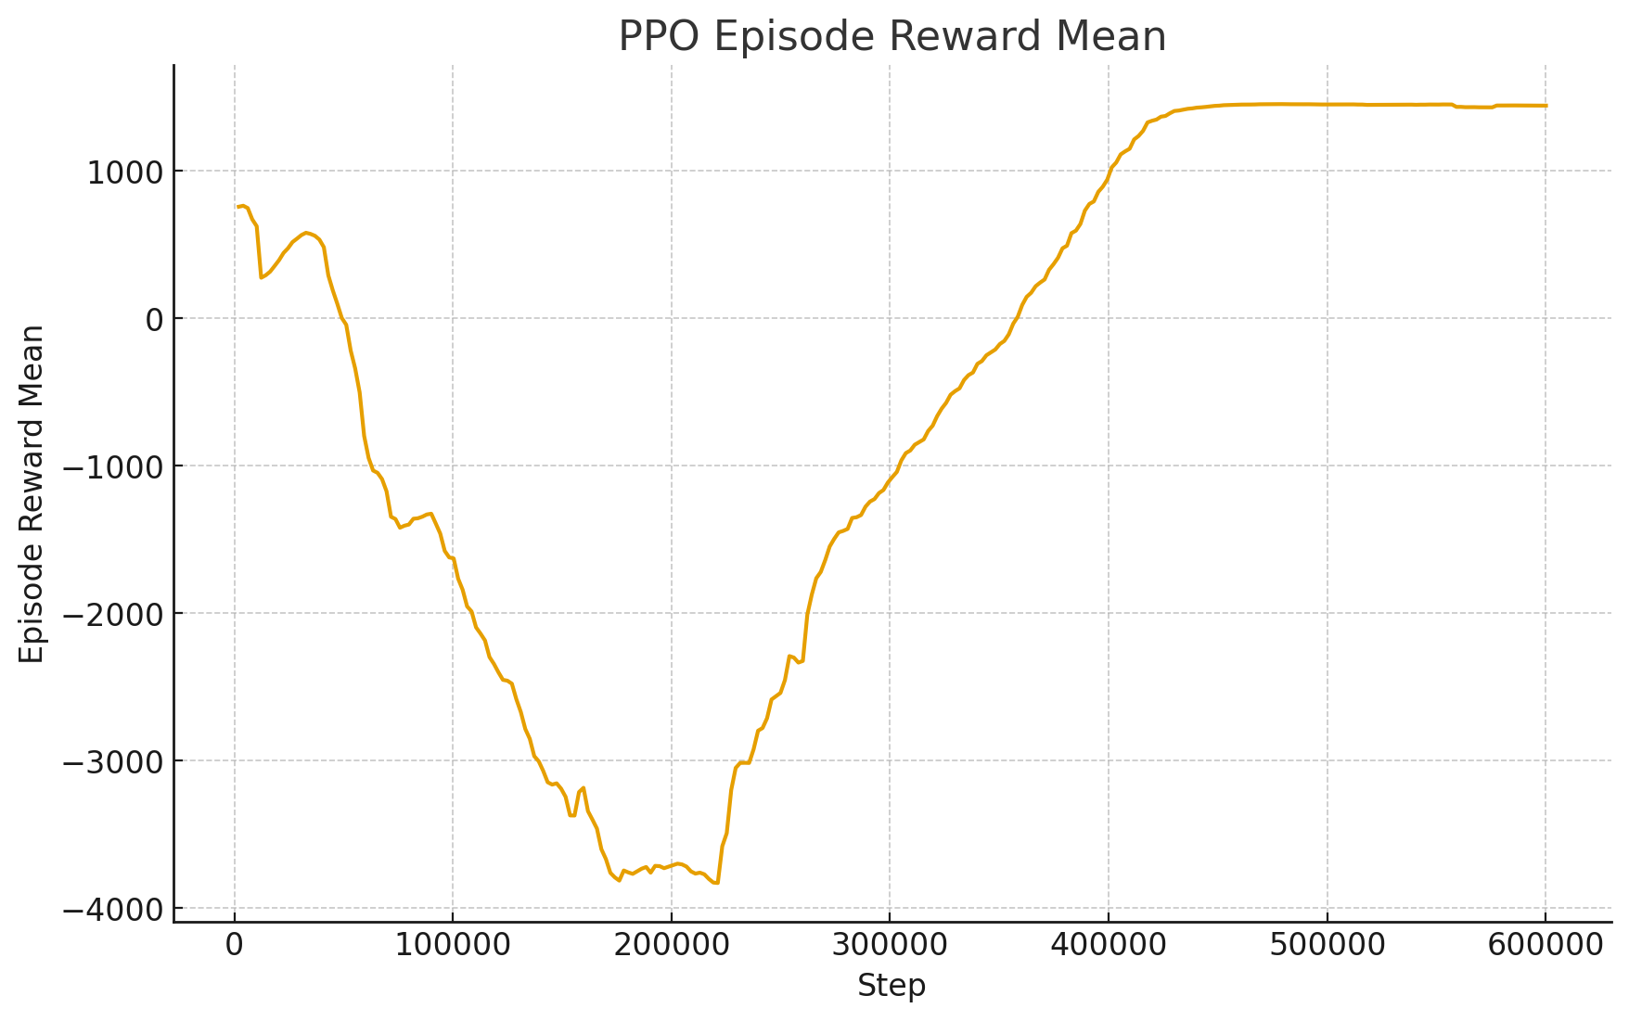
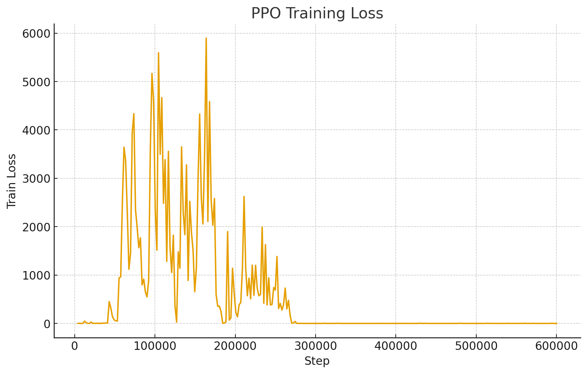
Experiment Results
Training Results
(a)
(b)
(c)
Fig. 3: Training results of the MPC+RL agent using PPO. (a) Mean episode length. (b) Mean episode reward. (c) Training Loss
Training Hardware & Software
OS: Windows 11
CUDA 13.0
pytorch: 2.9.1
Graphics card: RTX 5070 TI

Slide 8
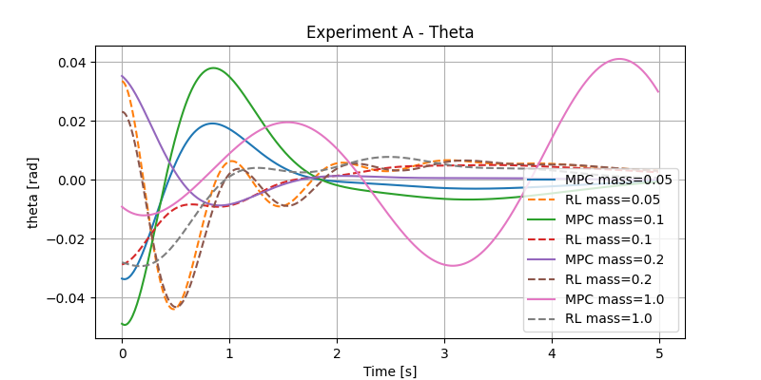
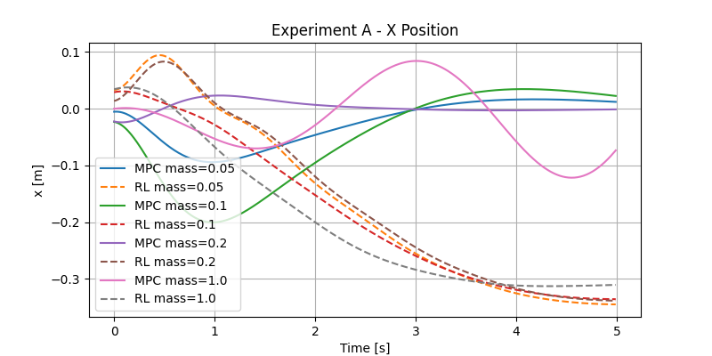
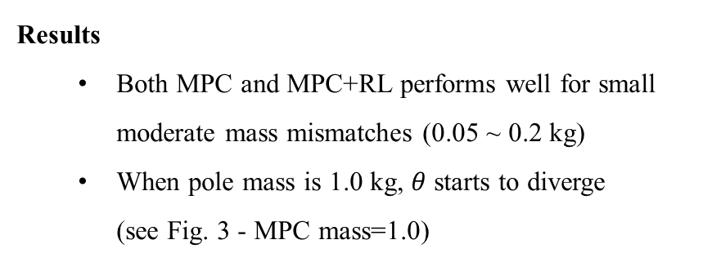
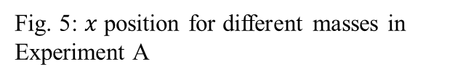
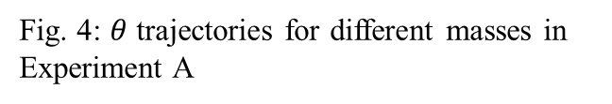
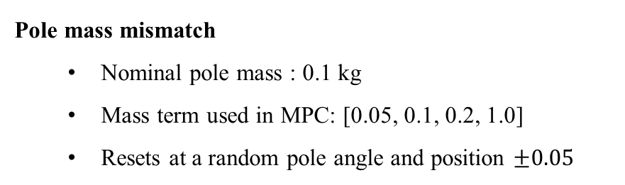
Experiment Results
Experiment A: Pole Mass Mismatch
Fig. 4: $θ$ trajectories for different masses in Experiment A
Fig. 5: $x$ position for different masses in Experiment A
Pole mass mismatch
Nominal pole mass : 0.1 kg
Mass term used in MPC: [0.05, 0.1, 0.2, 1.0]
Resets at a random pole angle and position $±0.05$
Results
Both MPC and MPC+RL performs well for small moderate mass mismatches (0.05 ~ 0.2 kg)
When pole mass is 1.0 kg, $θ$ starts to diverge (see Fig. 3 - MPC mass=1.0)

Slide 9
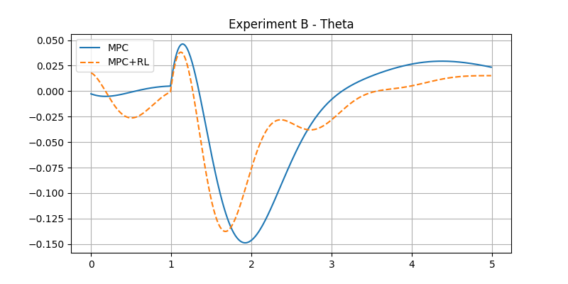
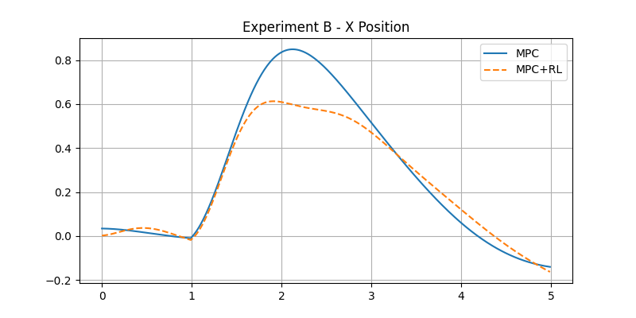
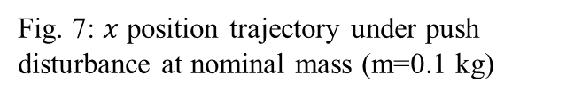
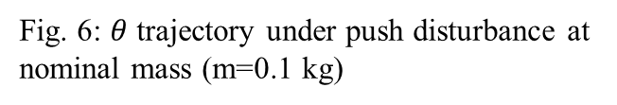
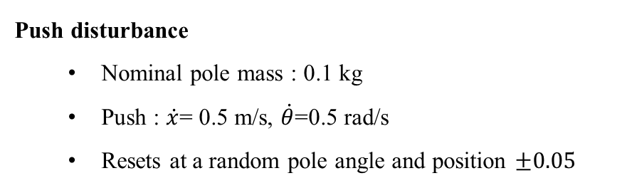
Experiment Results
Experiment B: Push disturbance
Fig. 6: $θ$ trajectory under push disturbance at nominal mass (m=0.1 kg)
Fig. 7: $x$ position trajectory under push disturbance at nominal mass (m=0.1 kg)
Push disturbance
Nominal pole mass : 0.1 kg
Push : $\dot{x}$= 0.5 m/s, $\dot{θ}$=0.5 rad/s
Resets at a random pole angle and position $±0.05$
Results
Fig. 5 and Fig. 6 show that the MPC+RL model has a smaller overshoot compared to the MPC only model.
The MPC+RL model shows less oscillatory behavior under push disturbance

Slide 10
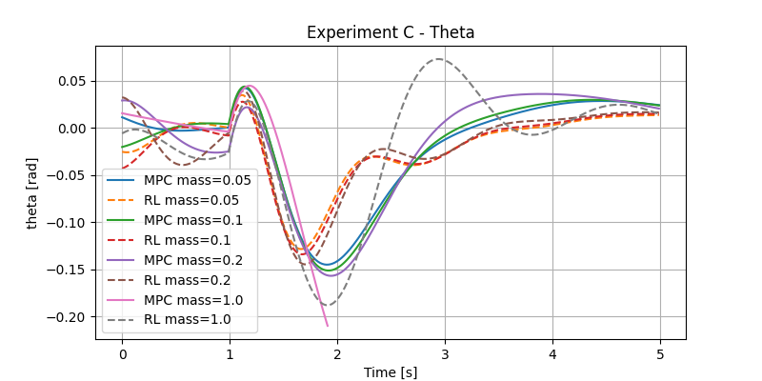
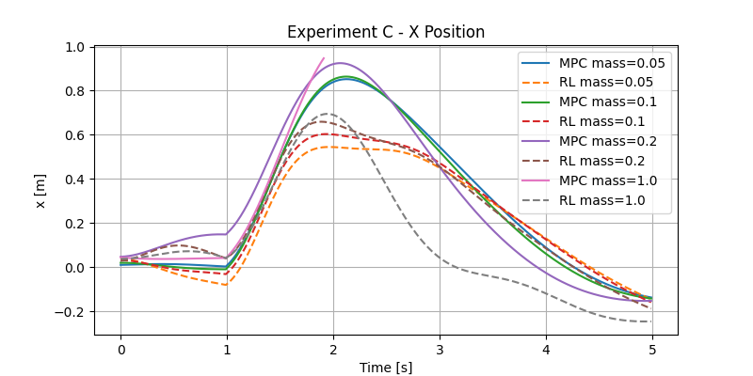
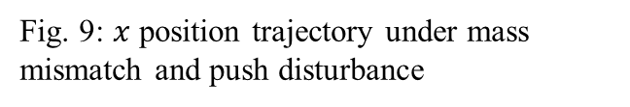
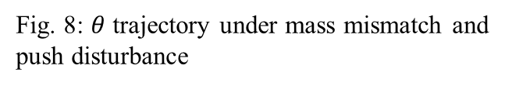
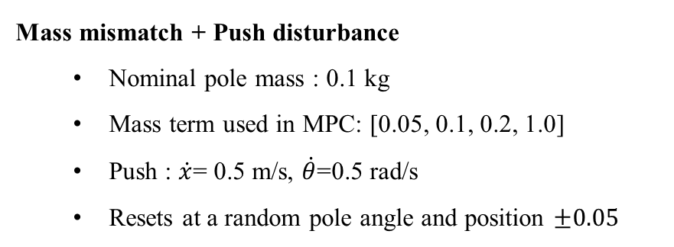
Experiment Results
Experiment C: Mass mismatch + Push disturbance
Fig. 8: $θ$ trajectory under mass mismatch and push disturbance
Fig. 9: $x$ position trajectory under mass mismatch and push disturbance
Mass mismatch + Push disturbance
Nominal pole mass : 0.1 kg
Mass term used in MPC: [0.05, 0.1, 0.2, 1.0]
Push : $\dot{x}$= 0.5 m/s, $\dot{θ}$=0.5 rad/s
Resets at a random pole angle and position $±0.05$
Results
Fig. 7 and Fig. 8 show that the MPC+RL model generally has a smaller overshoot compared to the MPC only model.
Model MPC mass=1.0 diverges while MPC+RL mass=1.0 converges

Slide 11
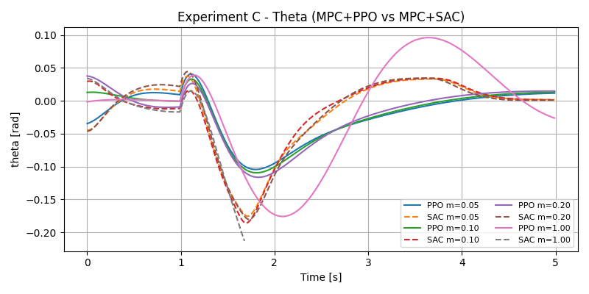
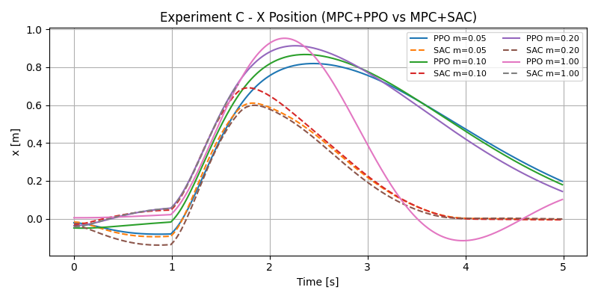
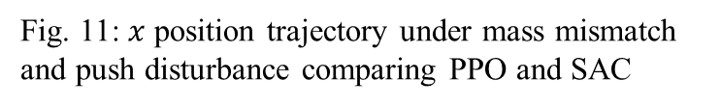
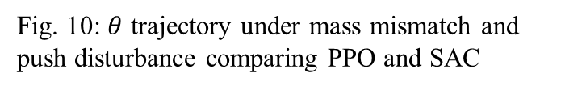
Comparison with SAC
Comparing MPC+RL policy, trained using PPO VS SAC
Fig. 10: $θ$ trajectory under mass mismatch and push disturbance comparing PPO and SAC
Fig. 11: $x$ position trajectory under mass mismatch and push disturbance comparing PPO and SAC
PPO VS SAC
Total timesteps PPO: 600k, SAC: 100k To keep the total training duration comparable between algorithms, SAC was run for fewer steps.
Results
As can be seen in Fig. 10 and Fig. 11, PPO and SAC performed similarly
In some cases, the response time is slightly better for SAC

Slide 12
Results & Conclusion
<Results>
Both MPC and MPC+RL controllers perform similarly under small model mismatches
However, when model mismatch is large, the MPC+RL controller performs noticeably better than MPC only
Specifically, MPC+RL models seem to have smaller overshoot while converging faster than MPC only
MPC+RL models have less oscillatory behaviors under push disturbances
Experiment B shows that compared to a well tuned MPC controller, MPC+RL controller is more robust under push disturbances
Comparison between the algorithms trained by PPO and SAC showed similar results between the two training methods
SAC required significantly more training time compared to PPO
<Conclusion>
Under mild model mismatch and no disturbances, MPC performs as well as MPC+RL
Under large model mismatch without disturbances, MPC fails while MPC+RL maintains partial stability
Overall, the combined controller demonstrates clear benefits in robustness when the system experiences parameter uncertainty or unmodeled nonlinear effects

Slide 13
References
C. E. García, D. M. Prett, and M. Morari, “Model predictive control: Theory and practice — a survey,” Automatica, vol. 25, no. 3, pp. 335–348, May 1989.
A. Bemporad and M. Morari, “Robust model predictive control: A survey,” in Robustness in Identification and Control, A. Garulli, A. Tesi, and A. Vicino, Eds., Lecture Notes in Control and Information Sciences, vol. 245, Springer-Verlag, London, 1999, pp. 207–226. doi:10.1007/BFb0109870
E. Camacho and C. Bordons, Model Predictive Control, 2nd ed., London, UK: Springer, 2007.
M. Nikolaou, “Model predictive controllers: A critical synthesis of theory and industrial needs,” Advances in Chemical Engineering, vol. 26, Academic Press, 2001, pp. 131–204.
A. Bemporad, F. Borrelli, and M. Morari, “Model predictive control based on linear programming — The explicit solution,” IEEE Trans. Autom. Control, vol. 47, no. 12, pp. 1974–1985, 2002.
Forgione, M., Piga, D. and Bemporad, A., 2020. Efficient calibration of embedded MPC. IFAC-PapersOnLine, 53(2), pp.5189-5194.

